Slide 1
While you wait
Log it at : www.sli.do
Join using Event Code:
#TASL

Slide 2
Reading, Relationships, and Resources
Creating a Lively and Sustainable Library Program
Presented by: Lakisha Brinson
@lakishabrinson
Notes:
Greetings all,
I am glad to have the opportunity to share and learn from you all today. A little background (teacher, STEM Instructional Designer, Librarian, District Library Coach) now MS Technology Integrationist at University School of Nashville.
I want to be transparent here and say that while I feel what we discuss today will speak to how we can creating lively and sustainable library programs; our overarching focus is looking at how we can create libraries of the future.

Slide 3
How are you preparing your
library for the future?
Notes:
Shannon McClintock Miller, Future Ready Librarians and Project Connect Spokesperson
Mark Ray, Future Ready Librarians Lead

Slide 4
Future Ready Framework
Grew out to Project CONNECT
Alliance for Education
Connect practices to Future Ready Schools
Notes:
President Obama launched the Future Ready Initiative in November 2014 at the White House. Today, more than 2400 district superintendents have signed the Future Ready Schools Plan
Core is Personalized Student Learning

Slide 5
Librarians are integral
Curating digital resources and tools
Empowering students as creators
Building instructional partnerships
Designing collaborative spaces
Notes:
The Future Ready Librarians Framework acknowledges that librarians play a key role in

Slide 6
Notes:
Today what I will share though grounded in the Future Ready Librarians framework are components that will help each of our libraries become more lively and sustainable.
At times you will immediately be able to say Oh, yea I do this by…… and that’s great. Other areas we get to you may have to stretch your thinking some; and that’s okay.
Let’s commit in these next 40 minutes to rethink some of the things we are doing/will do and frame our conversations in a way that gives us a language to take to our administrators, teachers, and community .

Slide 7
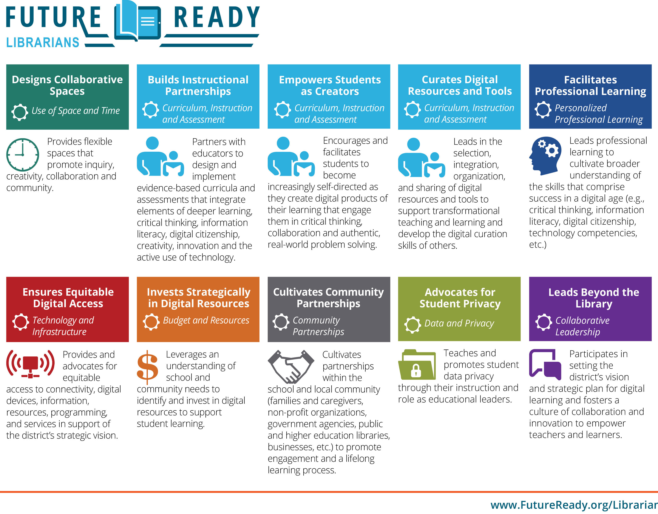
Notes:
Future Ready Framework outlines 10 key areas where librarians can serve as leaders.
Let’s explore Designing Collaborative Spaces
Wisconsin Libraries have a collection of questions we can ask ourself when looking at each component.

Slide 8
Designing Collaborative Spaces
Provides flexible spaces that promote inquiry, creativity, collaboration and community
Design Thinking for Libraries
Notes:
Design thinking is a creative approach, or a series of steps, that will help you design meaningful solutions for your library
Provides flexible spaces that promote inquiry, creativity, collaboration and community.
How does your library space promote inquiry?
How does your library space promote collaboration?
What is available in your library space to encourage creativity?
Is your space accessible for the school community?

Slide 9
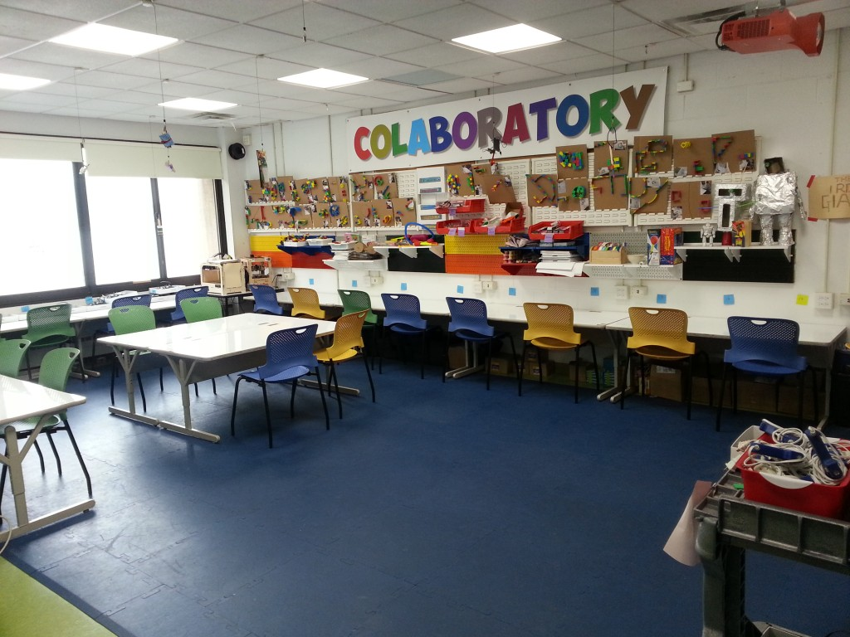
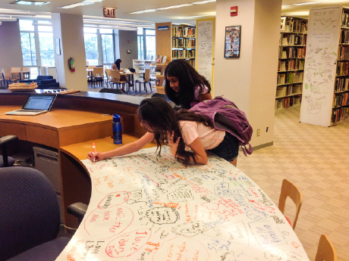
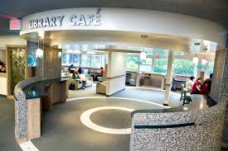
Notes:
It’s all in a name …this media specialist changed his/her space to be called Colaboratory.
Other examples that we commonly see are lego walls, Cafe’s, White board desks.

Slide 10
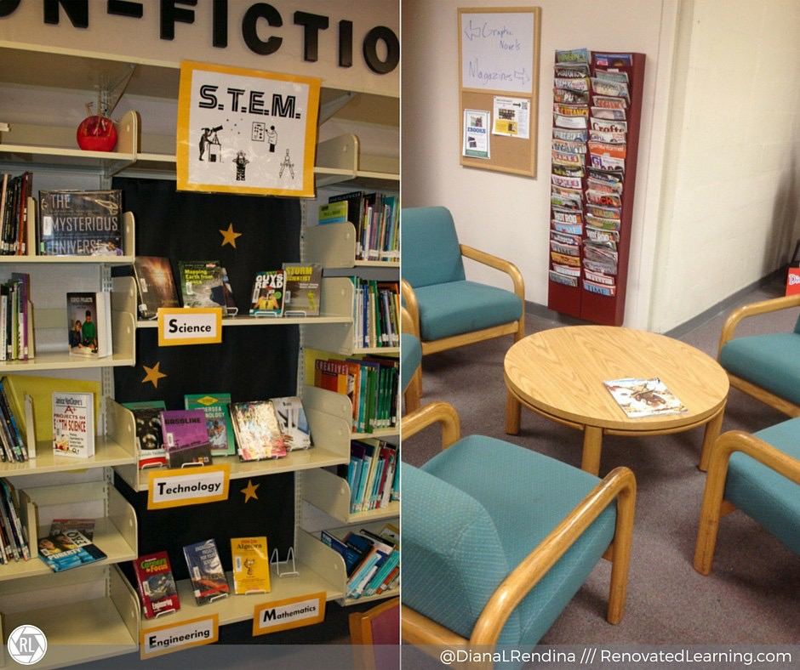
@DianaLRendina
Notes:
Get ideas from others in the field…. one person that you can glean some ideas from is
@ DianaLRedina , has a blog called Renovated Learning (talks about Maker Movement)
@Laura Fleming ( Makerspace)
Library Girl- Mcgavor your library

Slide 11
Notes:
Now lets look at…

Slide 12
Building Instructional Partnerships
Partners with educators to design and implement evidence-based curricula and assessments that integrate elements of deeper learning, critical thinking, information literacy, digital citizenship, creativity, innovation and the active use of technology.
Notes:
How are you leveraging digital tools and resources to improve your instructional practice?
Do you model effective integration across content areas?
Do you encourage through collaboration the strategies for encouraging discovery, analysis, creation and presentation?

Slide 13
Messages
Meetings
Notes:
From Kinder up we can serve as proponents of Online Safety tips (Common Sense Media—bootcamp)
While we’d love to be at meetings more frequently-start small ask for once a month standing meeting with teams.
One legged interviews: in between classes in hall 1st ask about them personally then go into how are those resources on citing sources working for you and your students.

Slide 14
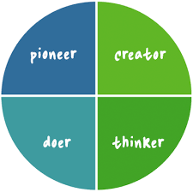
Be a Lead Learner
Notes:
Become aware of various learning strategies, offer to model a technique ( digging for information)

Slide 15
Notes:
Now lets look at…

Slide 16
Empowering Students as Creators
Encourages and facilitates students to become increasingly self-directed as they create digital products of their learning that engage them in critical thinking, collaboration and authentic, real-world problem solving.
Notes:
Do you have spaces for students to create digital products documenting their learning?
What types of library instruction do you use to promote critical thinking?
How does your program support connections to the community?
What do you include in your program to support real-world problem solving by students?

Slide 17
Notes:
Be a resources for different tools students can use to be creative
Find ways to link curriculum to real world experiences (guest speakers)
Explore Wonderopolis (Have a Wonder of the Day)

Slide 18
Empowering Students
Notes:
What learning philosophies does you school embody? PBL, Challenge Based Thinking, Limited Worksheets, etc
Be able to speak to the main concepts of that philosophy (not the expert but aware)
Invent to Learn: Tinkering and Making: Coding, 3D printers, etc…
Inventors Mindset -all about bring creativity out of students, how to fosters student questions (inquiry)
Kids deserve It- talks about being the best educator you can be, challenging yourself, taking risks all the things we want our students to do

Slide 20
Notes:
Now lets look at…

Slide 21
Curates Digital Resources and Tools
(Curriculum, Instruction, and Assessment)
Leads in the selection, integration, organization, and sharing of digital resources and tools to support transformational teaching and learning and develop the digital creation skills of others.
Notes:
Does your selection and reconsideration policy include collection development information and processes addressing digital resources and tools?
Are Open Education Resources (OER) included in your collection development plan?

Slide 22
Online Databases
Library Webpage
“At the end of the day the most effective way to alter people’s behavior is to make them as aware as you possibly can on ways to improve”
John Walls
Google Teacher Tribe Podcast
AASL Best Websites and Apps
Notes:
We lead them to the water and when there thirsty enough they will drink……..

Slide 24
Notes:
Moving right along

Slide 25
Facilitates Professional Learning
(Personalized Professional Learning)
Leads professional learning to cultivate broader understanding of the skill that comprise success in a digital age (e.g. critical thinking, information, literacy, digital citizenship, technology competencies, etc.)
Notes:
Does the LMS provide or facilitate professional development?
What format do you use to provide professional development?
How do the librarians identify the professional learning needs of their staff related to technology and information literacy resources and tools?
Do you provide professional development on strategies for encouraging discovery, analysis, creation and presentation of learning?

Slide 26
Notes:
Build capacity with those in the building host may PD sessions where other teachers highlight tools they are using; like Tech Speed Dating. Another activity that I have done is the TECH Petting zoo’s.

Slide 27
Notes:
This next one is one where we must lean into our district Technical Departments (IT or TSS)

Slide 28
Ensures Equitable Digital Access
(Technology and Infrastructure)
Provides and advocates for equitable access to connectivity, digital devices, information, resources, programming, and services in support of the district’s strategic vision.
Notes:
How does your library plan align to the district strategic plan?
Does your program utilize digital tools to support and promote equitable access to information and resources through your library media program?
How does your district support the library program to ensure students have access to the resources, human and physical, they need to optimize their learning?

Slide 29
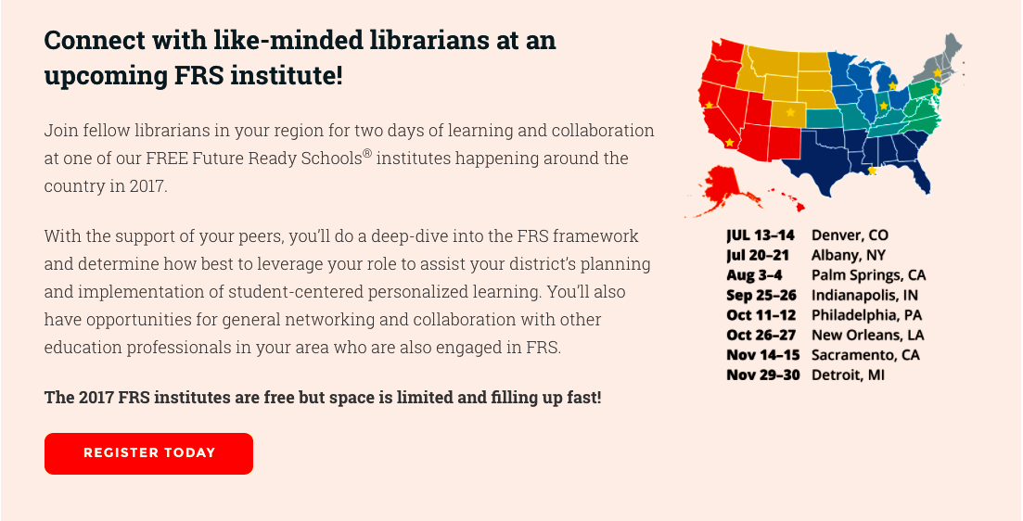
Future Ready Institutes
Notes:
Who’s telling your story?
Connect practice to district priorities
(What does your district/ principal speak of) (what keeps your admin up at now)

Slide 30
Notes:
Raise your words— share your views on what programs, resources, etc would be most beneficial for the school body.

Slide 32
Invests Strategically in Digital Resources
(Budget and Resources)
Leverages an understanding of school and community needs to identify and invest in digital resources to support student learning.
Notes:
**This points to the importance of being on the leadership team**
Serving on TASL Board, TLA, becoming volunteers (AASL))
How is the librarian involved in the district planning for digital resources?
How is the librarian currently involved in the school and district planning processes?
Are there any areas of communication that need to be improved?

Slide 33
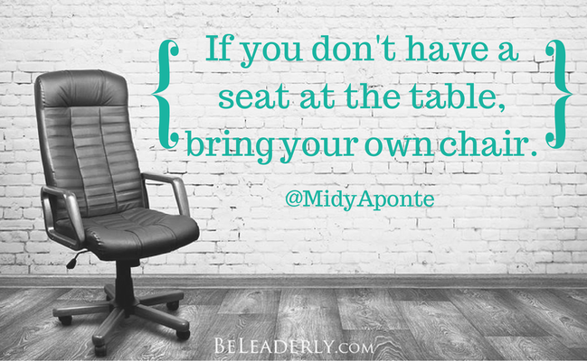
Notes:
Volunteer/ask to join committees and boards in school and in the community.
TSLA/TLA,

Slide 34
Notes:
Reaching outside our space

Slide 35
Cultivates Community Partnerships
(Community Partnerships)
Cultivates partnerships within the school and local community (families and caregivers, non-profit organizations, government agencies, public and higher education libraries, businesses, etc.) to promote engagement and a lifelong learning process
Notes:
What partnerships currently exist with the community?
What partnerships do you plan to cultivate?
What strategies can you use to build stronger community partnerships?

Slide 36
Public Library
School Pencil Partners
“Coming together is a beginning, staying together is progress, and working together is success”
Henry Ford
Neighboring School Libraries
Business Owners, Non-Profit

Slide 37
Notes:
Future Ready Framework outlines 8 key areas where librarians can serve as leaders.

Slide 38
Advocates for Student Privacy
(Data and Privacy)
Teaches and promotes student data privacy through their instruction and role as educational leaders.
Notes:
What student privacy policies are currently in place in your district?
Is everyone in the district current on those policies?
Are there opportunities for you to provide leadership in building broader understanding and awareness of those policies?
How does the librarian and the library program promote and support digital citizenship?

Slide 39
Notes:
Awareness is key—
Giving teachers tidbits of information on

Slide 40
Notes:
Future Ready Framework outlines 8 key areas where librarians can serve as leaders.

Slide 41
Leads Beyond the Library
(Collaborative Leadership)
Participates in setting the district’s vision and strategic plan for digital learning and fosters a culture of collaboration and innovation to empower teachers and learners.
Notes:
Are you involved in the district strategic planning process?
How does the librarian communicate what the library program does to support other district goals (equity, access to resources and space, etc.)?
How do you identify any roadblocks to collaborative leadership and ways to move beyond them?
Is there a plan to evaluate and analyze the library program through usage data and program statistics?

Slide 42
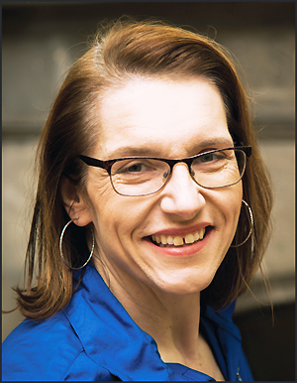
Member Highlights
Erica Long
@bookishbulldawg
AASL Social Justice Defender
Carol Nanney
Regional Finalist Teacher of the Year
Amanda Smith
@asmithfield
SLJ 2o16 Mover and Shaker
Suzanne Costner
Top Humanities Educator and 2017 Aerospace Teacher of the year
Notes:
Want to take this time to highlight just a few of our TASL member who are leading beyond the library.

Slide 43
Can’t forget
Being here today
Joining TASL chats
Subscribing to professional journals
Talking to other librarians
Notes:
You are also leaders: you show your leadership by

Slide 45
Something to Ponder
Start a different conversation (ways that I hope to meet school goals)
Focus on one component of Future Ready Framework and share it with administrators, teachers, and the community
Suspend disbelief that administrators don't care or don't get it.
Notes:
This next video is a reminder to us that we have an amazing opportunity as librarians to impact the lives of students and teachers.

